Slide 1
30th WLPG
Marrakech - Morocco
LPG in Brazil: New Challenges
Aurélio Cesar Nogueira Amaral
Director

Slide 2

ABOUT ANP
ANP contracts, supervises and regulates the oil,
natural gas and biofuels activities
Federal Administration
Board of Directors (1 General Director and 4 Directors)
Autonomous decisions through deliberative sessions of the Board of Directors
Major decisions are submitted to public hearings
Main office in Rio de Janeiro.
Regional Offices in Brasília, Salvador, São Paulo, Manaus, Belo Horizonte and Porto Alegre.

Slide 3
PLAYERS
SUPPLIERS
18 Refineries
384 Ethanol plants
398 Importers and Exporters
50 Biodiesel producers
WHOLESALE
154 Liquid Fuels
20 LPG
7 Aviation Fuel
RETAIL
41,697 Liquid Fuels
67,377 LPG
375 TRR – small diesel dealer
249 Aviation Fuel
CUSTOMERS
16,810 Supply facilities
More than 120,000 players
* Source: ANP. August 4, 2017.
Notes:
Conforme Boletim do Abastecimento n° 55 – Posição de 4 de agosto de 2017.

Slide 4
DOMESTIC FUEL SALES
Fuel | Thousand m³ |  |  |  |  | Volume change |  | Thousand m³ |  | Volume change
 | 2012 | 2013 | 2014 | 2015 | 2016 | 16/15 (%) |  | 2016 (Jan-Aug) | 2017 (Jan-Aug) | 17/16 (%) (Jan-Aug)
Diesel B | 55.900 | 58.571 | 60.032 | 57.211 | 54.279 | -5,1% |  | 36.268 | 36.124 | -0,4%
Biodiesel (B100) | 2.762 | 2.929 | 3.410 | 4.005 | 3.799 | -5,1% |  | 2.539 | 2.810 | 10,7%
Gasoline C | 39.698 | 41.428 | 44.364 | 41.137 | 43.019 | 4,6% |  | 27.885 | 29.902 | 7,2%
Gasoline A | 31.758 | 31.679 | 33.273 | 30.204 | 31.404 | 4,0% |  | 20.356 | 21.829 | 7,2%
Anhydrous ethanol | 7.940 | 9.686 | 11.091 | 10.934 | 11.615 | 6,2% |  | 7.529 | 8.074 | 7,2%
Hydrous ethanol | 9.850 | 11.755 | 12.994 | 17.863 | 14.586 | -18,3% |  | 9.892 | 8.033 | -18,8%
Total ethanol | 17.790 | 21.441 | 24.085 | 28.796 | 26.201 | -9,0% |  | 17.421 | 16.107 | -7,5%
Total Cycle Otto | 49.548 | 53.183 | 57.358 | 59.000 | 57.605 | -2,4% |  | 37.777 | 37.936 | 0,4%
LPG | 12.926 | 13.276 | 13.410 | 13.249 | 13.398 | 1,1% |  | 8.921 | 8.966 | 0,5%
Fuel oil | 3.934 | 4.990 | 6.195 | 4.932 | 3.333 | -32,4% |  | 2.230 | 1.988 | -10,8%
JET | 7.292 | 7.225 | 7.470 | 7.355 | 6.765 | -8,0% |  | 4.568 | 4.406 | -3,6%
GAV | 76 | 77 | 76 | 64 | 57 | -10,2% |  | 38 | 35 | -9,1%
TOTAL | 129.677 | 137.323 | 144.541 | 141.811 | 135.436 | -4,5% |  | 89.804 | 89.454 | -0,4%

Slide 5
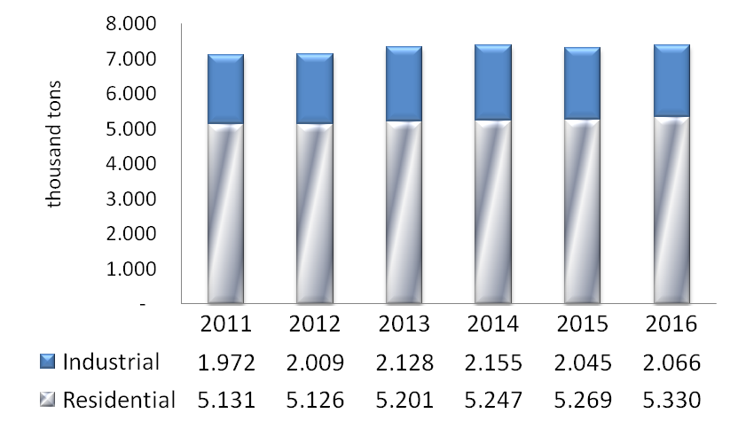
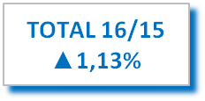
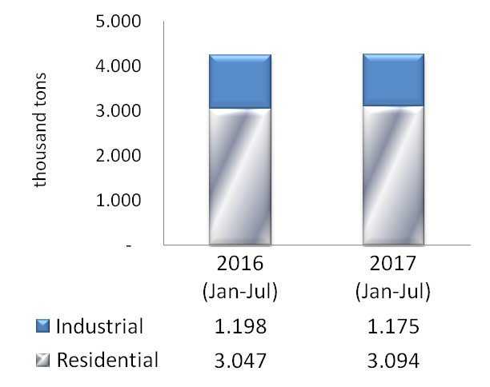
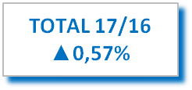
DOMESTIC LPG CONSUMPTION
8,000
7,000
6,000
5,000
4,000
3,000
2,000
1,000
1.13%
5,000
4,000
3,000
2,000
1,000
1,972 2,009 2,128 2,155 2,045 2,066
5,131 5,126 5,201 5,247 5,269 5,330
Total 7,103 7,135 7,329 7,402 7,314 7,396
1,198 1,175
3,047 3,094
0.57%
Total 4,245 4,269
* Source: ANP.
Notes:
Comparação 2016/2015:
O consumo total de GLP aumentou 1,13% em 2016.
O segmento “P13” (vasilhames de até 13kg), de uso predominantemente residencial, cresceu 1,16%, enquanto o consumo industrial (“outros”) cresceu 1,05% no ano.
Comparação 2017/2016:
O consumo total de GLP, na comparação dos oito primeiros meses de 2017 em relação ao mesmo período de 2016, cresceu 0,57%.
No período considerado, o crescimento do segmento residencial foi de 1,54% e no segmento industrial houve queda de 1,90%

Slide 6
MARKET SHARE
Market Share Wholesale
23.09% 23.85%
22.60% 21.64%
20.48% 20.51%
19.25% 19.26%
8.18% 8.17%
3.15% 3.44%
1.76% 1.73%
0.75% 0.72%
0.44% 0.26%
0.12% 0.14%
0.18% 0.29%
* Source: ANP.

Slide 7
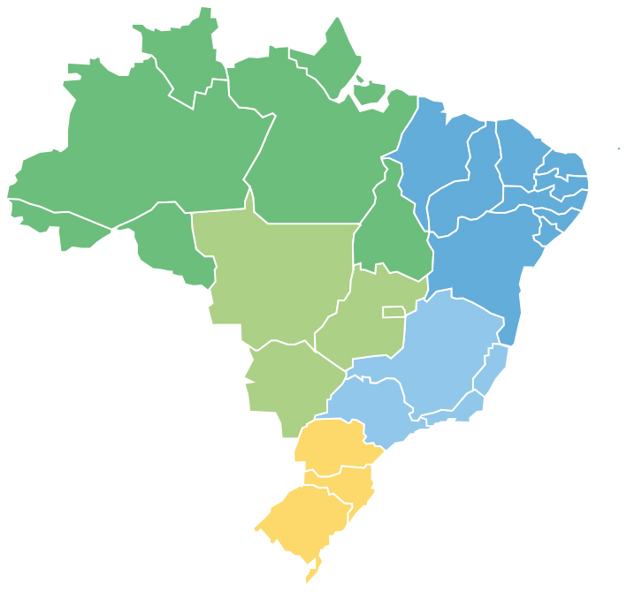
FOREIGN TRADE
LPG
2 ports account for 99.1% of imports
Suape (1st): 65.9% of imports
Santos (2nd): 33.2% of imports
Ports | 2016 (m³) |  | Jan - Aug 2016 (m³) |  | Jan - Aug 2017 (m³) |  | Evolution
Porto de Suape | 2,418,331 | 56.7% | 1,937,828 | 59.5% | 1,803,684 | 65.9% | -6.9%
Porto de Santos | 1,675,214 | 39.3% | 1,146,919 | 35.2% | 908,954 | 33.2% | -20.7%
Outros | 171,139 | 4.0% | 170,767 | 5.2% | 25,489 | 0.9% | -85.1%
* Source: SISCOMEX.
Notes:
Fonte: Boletim de Comércio Exterior, disponível no site da ANP.

Slide 8
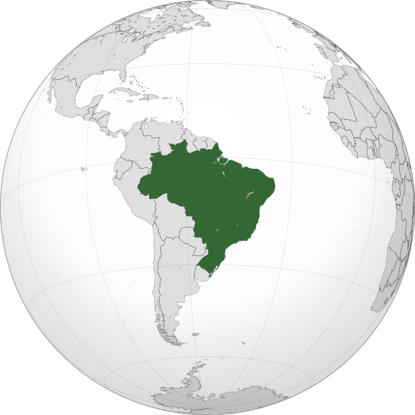
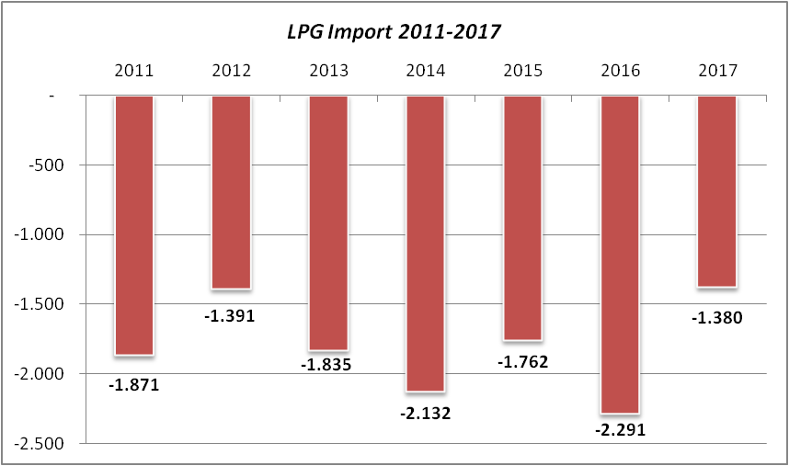
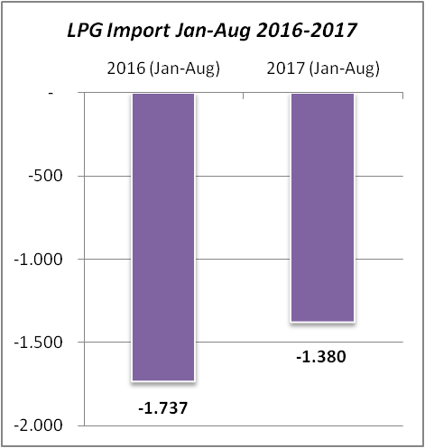
FOREIGN TRADE
Deficit Reduction
20.6%
-500
-500
-1,000
Thousand tons
-1,000
-1,500
-1,391
-1,380
-2,000
-1,835
-1,762
-1,500
-1,380
-1,871
-2,132
-2,291
-2,000
-1,737
-2,500
* Source: ANP and MDIC.
Notes:
Houve uma redução do déficit de 20,6% na comparação de janeiro a agosto de 2017 ao mesmo período do ano anterior.

Slide 9
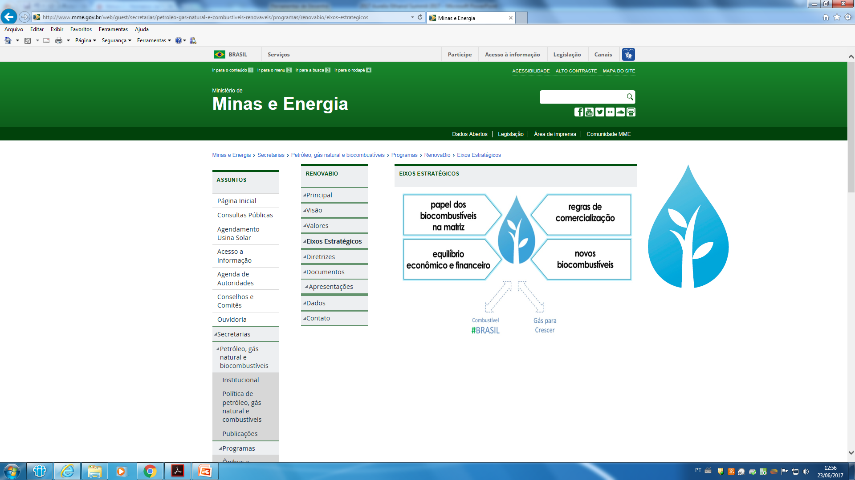
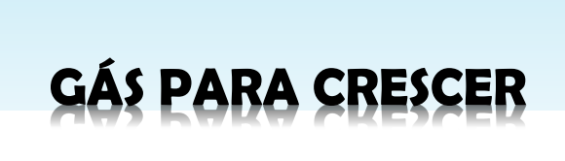
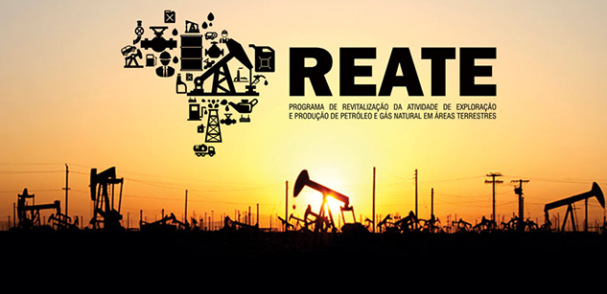
GOVERNMENT PROGRAMS
Notes:
Gás para Crescer (Gas to growth)- Adequar as atividades do setor de gás natural ao novo momento do mercado e à redução da participação da Petrobras em diversos segmentos da cadeia. Adotar de boas práticas internacionais; atração de investimentos; aumento da competição; diversidade de agentes; maior dinamismo e acesso à informação; participação ativa dos agentes do setor e respeito aos contratos firmados.
Reate (Brown fields revamp) - Revitalização das Atividades de Exploração e Produção de Petróleo e Gás Natural em Áreas Terrestres
Ações prioritárias a serem implementadas em três dimensões: 1 - políticas governamentais; 2 - regulação, 3 - infraestrutura e comercialização. Objetivos: revitalizar as atividades de E&P em áreas terrestres, estimular o desenvolvimento regional e aumentar a competitividade da indústria petrolífera onshore nacional.
Combustível Brasil (Fuel for Brazil)- Propor ações e medidas para garantir o fornecimento de combustíveis do Brasil, com ênfase no estímulo à entrada de novos atores no setor e à livre concorrência, em um ambiente regulatório objetivo e claro, pautado na transparência.
Renovabio (Biofuels growth, sustentabilty and lower emissons)- Como um dos fundamentos, destaca-se o reconhecimento da contribuição dos biocombustíveis para a segurança do abastecimento presente e futuro, o desenvolvimento regional e a redução de emissões globais e locais, e a expansão da produção de biocombustíveis no Brasil, baseada na previsibilidade, na sustentabilidade ambiental, econômica e social, e compatível com o crescimento do mercado.

Slide 10




COMBUSTÍVEL BRAZIL PROGRAM
STRATEGIC AXES
  Redesign the fuel supply scenario facing the new challenges of Petrobras
Rules for access and development of port infrastructures and fuel supply terminals
Goal
Propose actions and measures to guarantee Brazil’s fuel supply, with emphasis on encouraging new actors in the sector and free competition, in an objective and clear regulatory environment, based on transparency.
  Increase new investments in the supply sector, especially in refining and terminals
Encouraging competition in fuel markets
Vision
Brazil's fuel market, other oil products and biofuels compatible with market growth and capable of serving the Brazilian consumer in adequate price and quality conditions, in an objective, clear and favorable regulatory environment for investments to expand the sector.
Coordinators

Slide 11
PETROBRAS REPOSITIONING
Petrobras, through the Business and Administration Plan for the period 2017-2021 (PNG 17-21), outlined a strategy for the fuel chain:
  the promotion of new pricing and the margins of maximization of the value chain;
  the complete non-guarantee of the offer of the Brazilian market, understanding that in its business logic, there is a provision for the entry of more agents to the total demand for services; and
  the development of partnerships in the downstream, which will allow the introduction of new players in refining and logistics.
  Therefore, it is important to establish a new equilibrium in the Brazilian market and stakeholder participation, taking into account the levels of dependence from abroad, national refining facilities, prices and delivery conditions of products in foreign markets, as well as future expectations.

Slide 12

MARKET CONDITIONS
… there is no expectation of an increase in oil derivatives
Oil production is increasing while ....
kbpd
kbpd
  6 000
  6 000
5th largest oil products market
8th largest refining park
  4 500
  4 500
3 000
3 000
1.0%
  3%
  1 500
  1 500
It will take several investments in the coming years
0
0
2016
2018
2020
2022
2024
2026
2028
2030
2016
2018
2020
2022
2024
2026
2028
2030
National refining capacity
Oil Production (Petrobras + Third Parties)
National refining capacity
Oil products demand
Source: Petrobras (adapted)
Notes:
O mercado brasileiro continua a crescer e precisa de investimento: serão necessários R$30B até 2030, segundo estimativa do IBP

Slide 13
EXTERNAL DEPENDENCY 2016
2016
(thousand b/d)
2030
(thousand
b/d)
2030
Diesel A
139
424
Demand growth
3% per year
Otto Cycle
51
408
Subtotal
149
832
Fuel Aviation
22
120
LPG
72
70
Naphtha
158
120
Total
442
1,142
Increased overall deficit

Slide 14
INVESTMENTS
Investments in refineries need clear and stable rules for pricing products
Without new refineries or expanding existing ones, it is fundamental to invest in pipeline and port infrastructure for the import and distribution of products

Slide 15
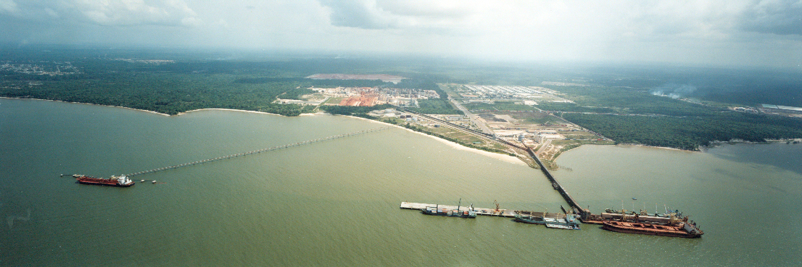
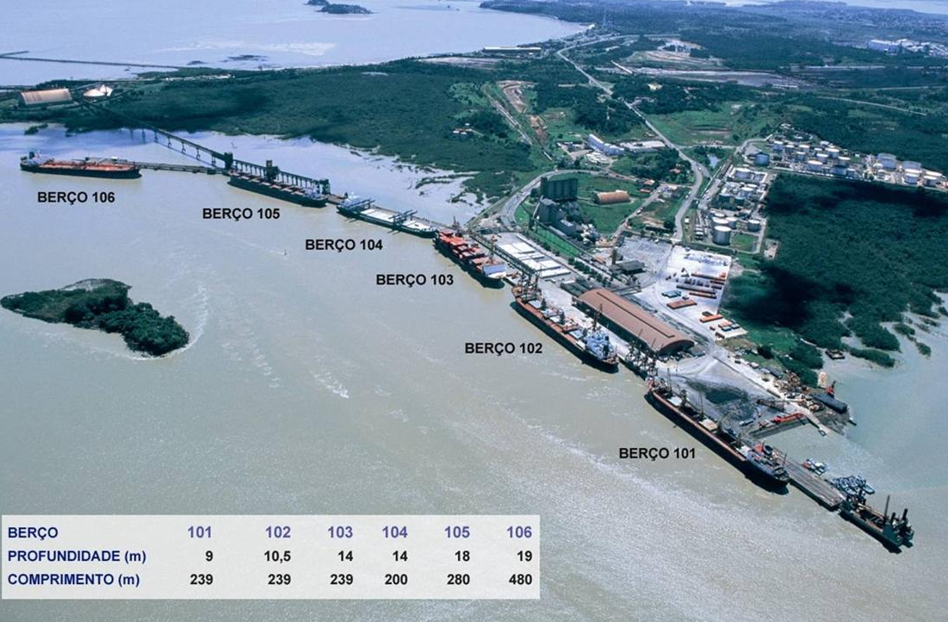
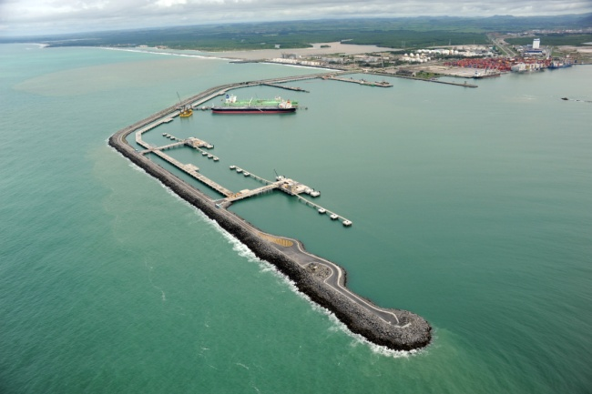
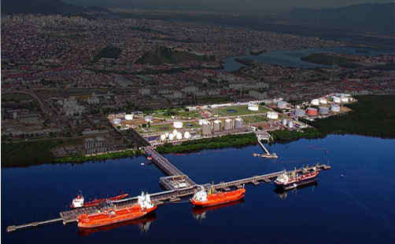
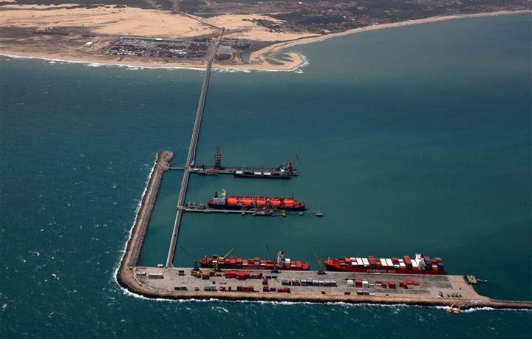
PORTS INVESTMENTS (ILLUSTRATIVE)
VILA DO CONDE
(Barcarena/PA)
ITAQUI
(São Luis/MA)
SUAPE
(Ipojuca/PE)
New (200 thousand m³)
Adaptation: lines, discharge and tanks
Adaptation: lines, discharge and tanks
TRANSPETRO
(Santos/SP)
PECEM
(S.G. Amarante/CE)
Adaptation: lines, discharge and tanks
New (200 thousand m³)
Notes:
Vila do Conde, Transpetro SC e Pecem são Terminais aquaviários de granéis líquidos. Também podem ser usados para armazenar outros líquidos. Porém, pelas características dessas regiões, o uso preponderante deve ser para armazenamento de combustíveis mesmo.

Slide 16
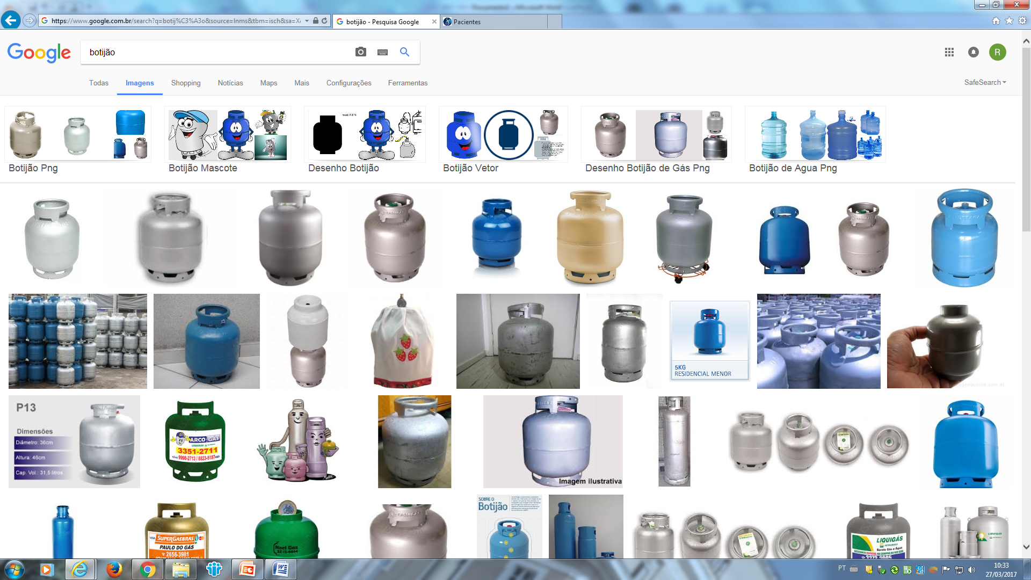
FINAL REMARKS
Brazil has a huge consumer market, but it is not self-sufficient.
The installed infrastructure for the production is not enough to support the continuous growth of demand for next 15 years.
Currently, Brazil is an excellent market for medium and long-term investors.

Slide 17
THANK YOU
AURÉLIO CESAR NOGUEIRA AMARAL
National Agency of Petroleum, Natural Gas and Biofuels – ANP
Director
www.anp.gov.br
aamaral@anp.gov.br

